Slide 1
K-Nearest Neighbour-KNN
Anuj Jain

Slide 2
What is KNN
K nearest neighbour is supervise learning algorithm.
K Nearest Neighbour is a simple algorithm that stored all the available cases.
KNN is used to classifies the new data or case based on a similarity measure.
KNN is a non parametric learning algorithm.

Slide 3
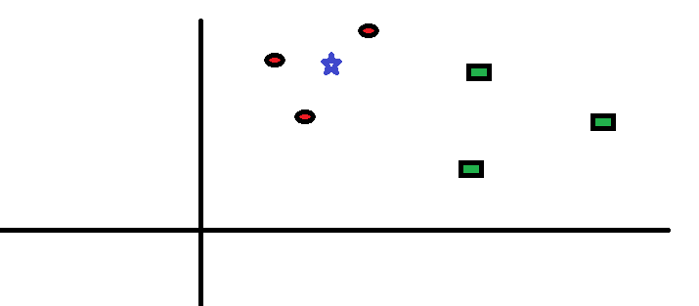
How does the KNN algorithm work?

Slide 4
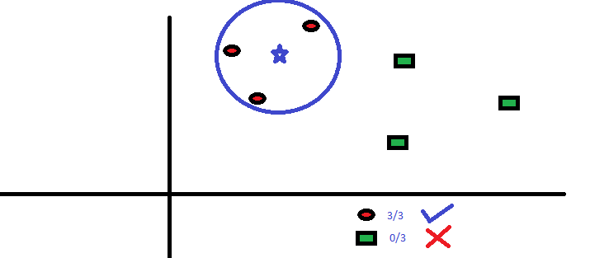

Slide 5
Best Prepare Data for KNN
Rescale Data: KNN performs much better if all of the data has the same scale. Normalizing your data to the range [0, 1] is a good idea. It may also be a good idea to standardize your data if it has a Gaussian distribution.
Address Missing Data: Missing data will mean that the distance between samples can not be calculated. These samples could be excluded or the missing values could be imputed.
Lower Dimensionality: KNN is suited for lower dimensional data. You can try it on high dimensional data (hundreds or thousands of input variables) but be aware that it may not perform as well as other techniques. KNN can benefit from feature selection that reduces the dimensionality of the input feature space.

Slide 6
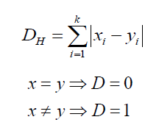
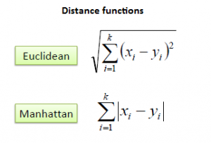
Methods of calculating distance between points
1. Euclidean Distance: Euclidean distance is calculated as the square root of the sum of the squared differences between a new point (x) and an existing point (y).
Manhattan Distance : This is the distance between real vectors using the sum of their absolute difference.
Hamming Distance: It is used for categorical variables. If the value (x) and the value (y) are same, the distance D will be equal to 0 . Otherwise D=1.

Slide 7
KNN Algorithm
Load the training and test data
Choose the value of K
For each point in test data: - find the Euclidean distance to all training data points.
- store the Euclidean distances in a list and sort it - choose the first k points - assign a class to the test point based on the majority of classes present in the chosen points 4. End

Slide 8
Understand the KNN Algorithm
We have a data from the questionnaires survey and objective testing with two attributes to classify whether a special paper tissue is good or not.
Now the factory produces a new paper tissue that pass laboratort test with X1=3 and X2=7 without expensive survey, can we guess what the class of this tissue paper.
S. No | Acid Durability | Strength | Class
1 | 7 | 7 | Bad
2 | 7 | 4 | Bad
3 | 3 | 4 | Good
4 | 1 | 4 | Good
5 | 4 | 4 | Good

Slide 9
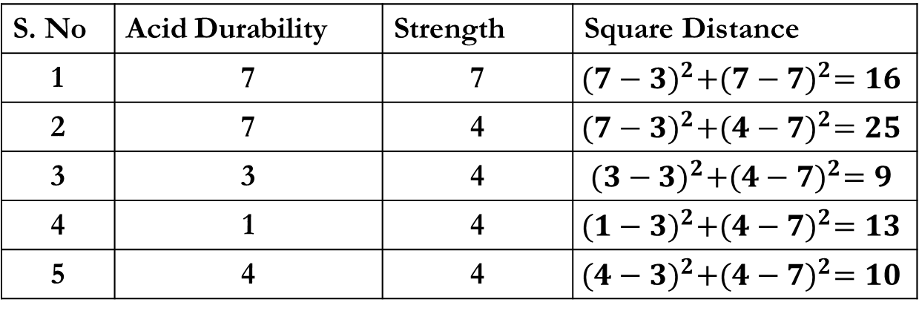
Understand the KNN Algorithm
Determine parameter K= number of the nearest neighbours. Suppose K=3
Calculate the distance between the query and all the training example.
S. No | Acid Durability | Strength | Square Distance
1 | 7 | 7 | $${(7−3)}^{2}+{(7−7)}^{2}=16$$
2 | 7 | 4 | $${(7−3)}^{2}+{(4−7)}^{2}=25$$
3 | 3 | 4 | $${(3−3)}^{2}+{(4−7)}^{2}=9$$
4 | 1 | 4 | $${(1−3)}^{2}+{(4−7)}^{2}=13$$
5 | 4 | 4 | $${(4−3)}^{2}+{(4−7)}^{2}=10$$

Slide 10
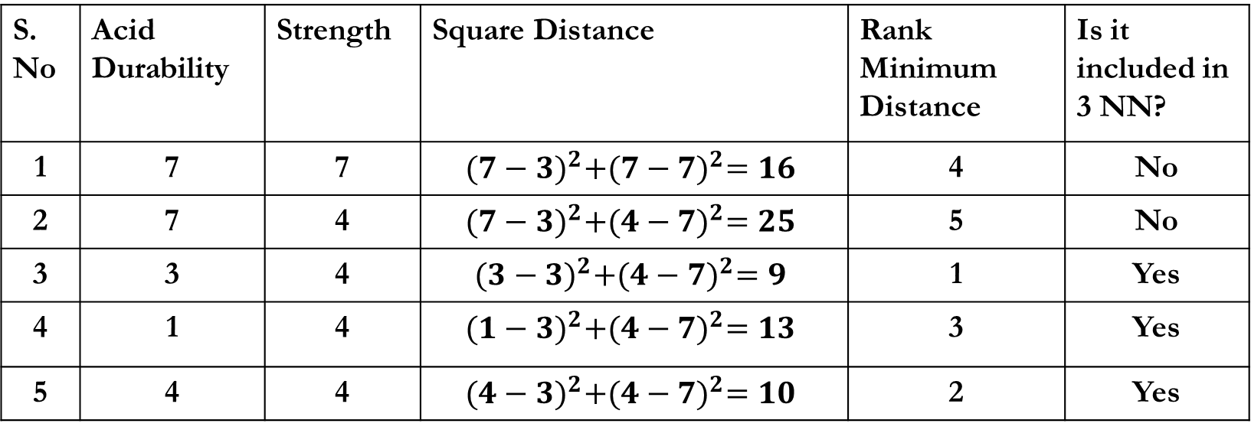
Understand the KNN Algorithm
Sort the distance and Determine the nearest neighbour bases on the kth minimum distance.
S. No | Acid Durability | Strength | Square Distance | Rank Minimum Distance | Is it included in 3 NN?
1 | 7 | 7 | $${(7−3)}^{2}+{(7−7)}^{2}=16$$ | 4 | No
2 | 7 | 4 | $${(7−3)}^{2}+{(4−7)}^{2}=25$$ | 5 | No
3 | 3 | 4 | $${(3−3)}^{2}+{(4−7)}^{2}=9$$ | 1 | Yes
4 | 1 | 4 | $${(1−3)}^{2}+{(4−7)}^{2}=13$$ | 3 | Yes
5 | 4 | 4 | $${(4−3)}^{2}+{(4−7)}^{2}=10$$ | 2 | Yes

Slide 11
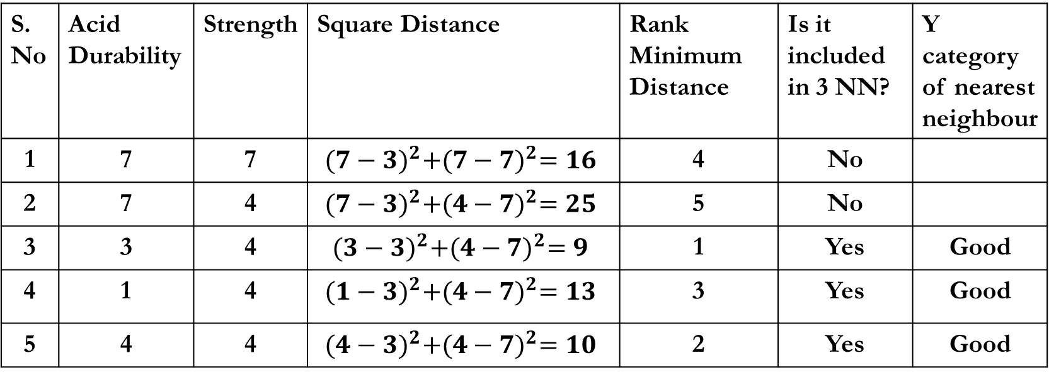
Understand the KNN Algorithm
Gather the category Y of the nearest neighbour. Notice in the second row last column that the category of nearest neighbour is not included because the rank of this data is more that 3.
S. No | Acid Durability | Strength | Square Distance | Rank Minimum Distance | Is it included in 3 NN? | Y category of nearest neighbour
1 | 7 | 7 | $${(7−3)}^{2}+{(7−7)}^{2}=16$$ | 4 | No
2 | 7 | 4 | $${(7−3)}^{2}+{(4−7)}^{2}=25$$ | 5 | No
3 | 3 | 4 | $${(3−3)}^{2}+{(4−7)}^{2}=9$$ | 1 | Yes | Good
4 | 1 | 4 | $${(1−3)}^{2}+{(4−7)}^{2}=13$$ | 3 | Yes | Good
5 | 4 | 4 | $${(4−3)}^{2}+{(4−7)}^{2}=10$$ | 2 | Yes | Good
We have 3 good and 0 bad then we conclude that new tissue paper include in good category.

